Slide 1
IF STATEMENTS & WHILE LOOPS

Slide 2
In the powerpoint, you will be introduced to if statements and while loops. They add “branches” to your code and acts based on whether the condition is true or false. They will be demonstrated using the same test kit.

Slide 3
Programming the Test Kit -- Buttons and If statements

Slide 4
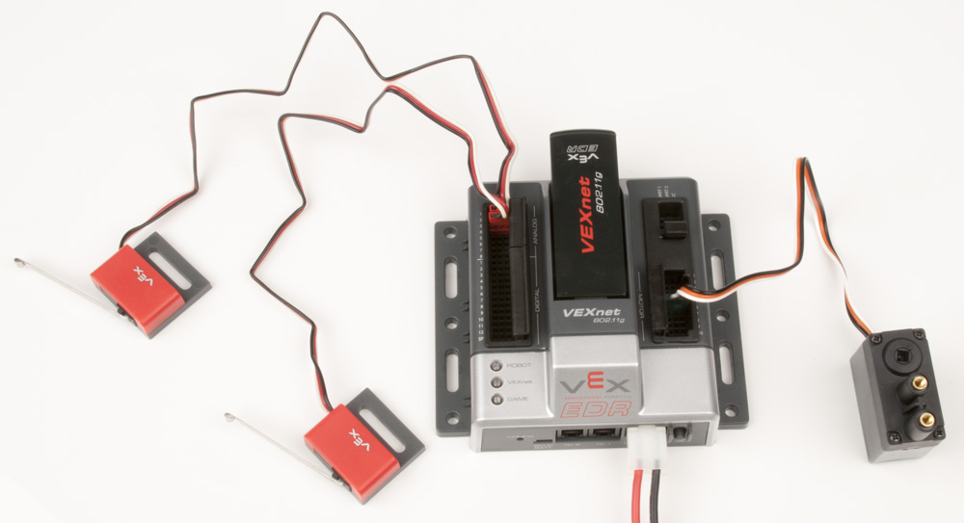
Set Up
Plug in the button in digital sensor port 1 of the cortex with the black wire facing out. The limit switch will work exactly the same.
*** The picture shows two limit switches plugged in ports 1 & 2.

Slide 5
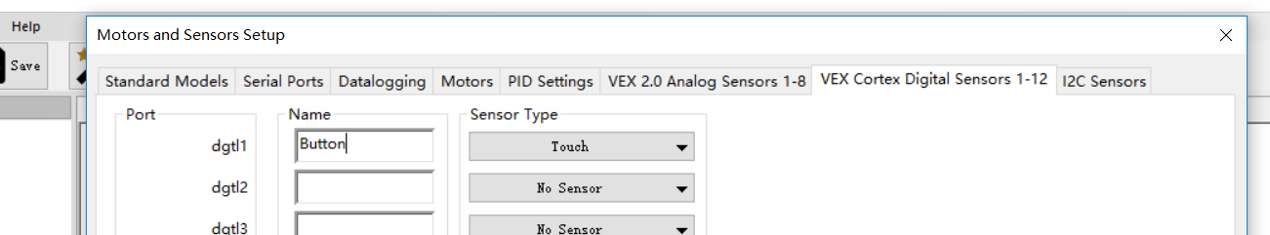
In the same ROBOTC file, go to “motor and sensor setup”, go under the “VEX Cortex Digital Sensors” tab, and change the sensor type in port 1 to Touch. Name it as “Button”. Hit “enter” to save the changes.
It doesn’t matter what you name it to, as long as you refer to it with that name in your code.

Slide 6
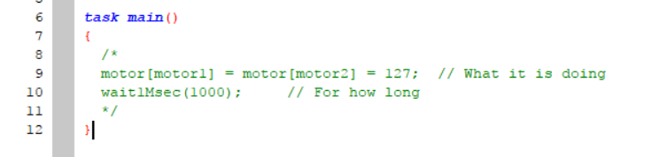
First of all, comment out all the previous code inside task main. You can put // in front of those lines, or place /* before the section, and */ after the section you want to comment out. These two symbols comment out all the code in between them.

Slide 7
Start
What we want to program the test kit to do is:
When the button is pressed, run the motors
When the button is not pressed, stop the motors
Repeat this process
Button pressed?
Yes
Loop
Back
Forever
No
Run the motor
This can be converted to more robotic logic:
Check whether the button is pressed
Yes! Now run the motor.
No. Now stop the motor.
Repeat this process
Stop the motor
Next step

Slide 8
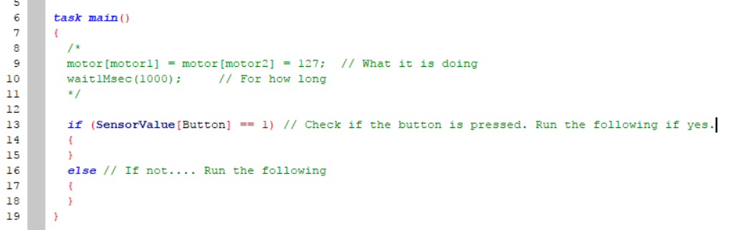
In the code above, we used something called the if loop:
if (conditions)
{
statements if condition is true
}
else
{
statements if condition is false
}
In the parenthesis (), we have the condition. This is what the code is checking.
If the condition is true, the block of code right under it will be run.
If the condition is false, the block of code after else will be run.
Brackets {} show that these lines of code belong to the same block.

Slide 9
In this case, the condition is whether the button is pressed. This is translated into robot language:
SensorValue[Button] == 1 inside the parenthesis.
Just like motor[motor1], SensorValue[Button] is specifying the sensor called button.
Unlike motors, we are not assigning a value to the sensor; here we want to check if the button is pressed.
For all touch sensors or joystick buttons, 1 means pressed, and 0 means not pressed.
Using double equal signs ==, we are comparing whether the right side is equal to the left side.

Slide 10
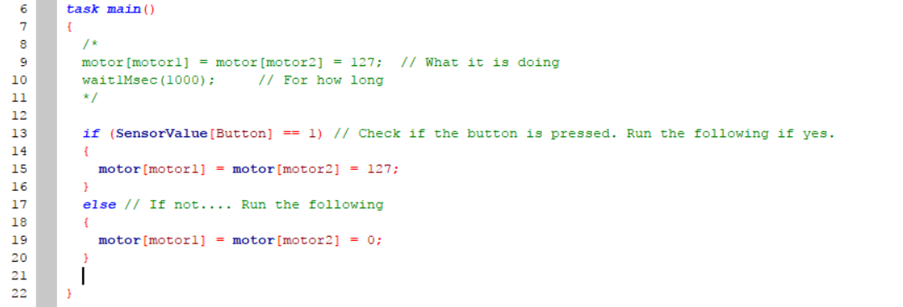
Now let’s add the code telling the motors what to do when the button is pressed or not pressed.
Translating back into human language, this code says:
Check if the sensor called button is pressed:
If yes, run both motors at full power.
If not, stop both motors.
Will this work if we download it to the kit? Why or why not?

Slide 11
Programming the Test Kit -- While Loops

Slide 12
Start
Going back to the flowchart, what we want to program the test kit to do is:
When the button is pressed, run the motors
When the button is not pressed, stop the motors
Repeat this process
Our code on the last slide was missing the part to repeat this process. We made a code telling the robot what to do, but not how long.
Button pressed?
Yes
Loop
Back
Forever
No
Run the motor
Stop the motor
Next step

Slide 13
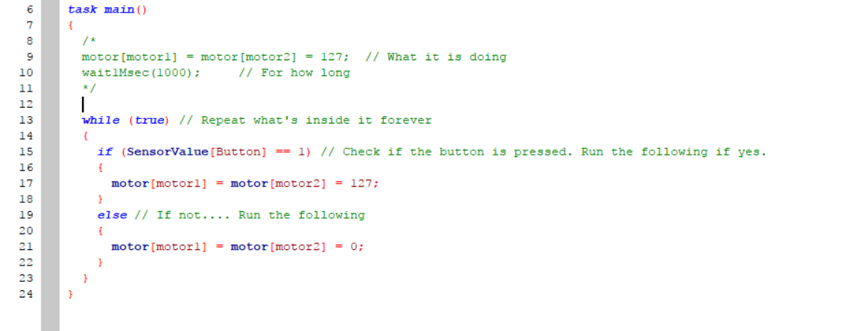
To make the cortex repeat something forever, we use a while (true) loop:
while (condition)
{
}
Like an if loop, the while loop check the condition in the parenthesis, and run its code block if that condition is true.
However, the if loop only checks the code once and moves on to the next block. The while loop keeps on checking its condition, and the block of code keeps on running as long as the condition is true.

Slide 14
In this case, the condition is “true”, which is true forever, and keeps the block running forever.
To represent true, you can also use “ 1==1 ”, or “1” as the condition. Like the buttons, 1 means true, and 0 means false in coding logic.

Slide 15
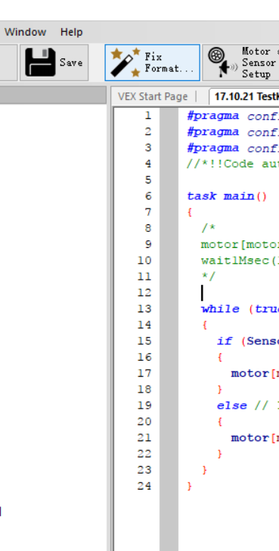
There are a lot of brackets {} once we start using loops. Sometimes, it can be difficult to figure out whether all brackets are closed properly.
A good habit is to always type out a set of brackets (opening and closing ones) first, before typing anything inside the brackets.
An easy way to line things up is by clicking the “Fix Format” button in the toolbar. After doing that, your last few brackets should form a staircase pattern and there shouldn’t be two close brackets } on the same indent level.

Slide 16
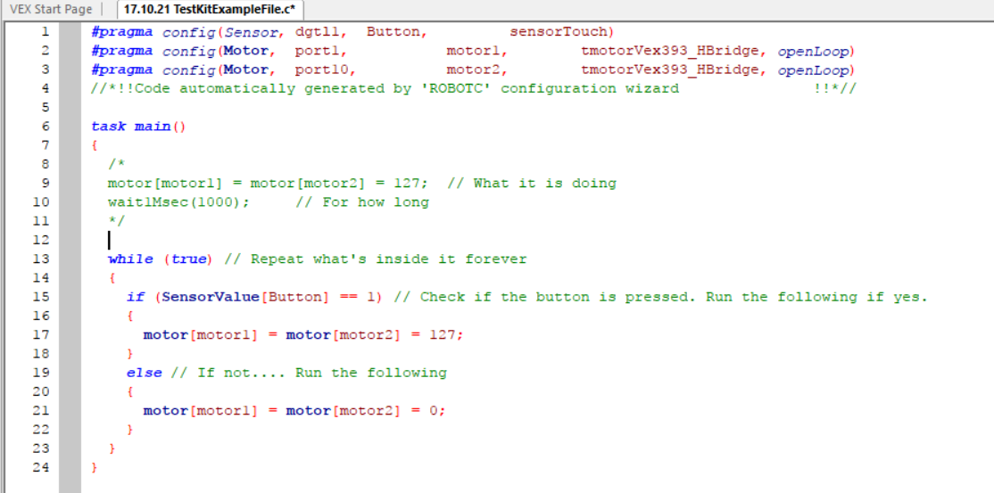
Download this to the cortex and try it out! If it works, congrats, the button is programmed properly!

Slide 17
Good job completing your first code with a sensor! The if statement and while loop are quite simple at a glance, but they are really useful in programming. For the majority of the in-class projects, you can get by with just this coding! Again congratulations, hope this powerpoint is helpful to your project.
For any questions or advice, please email alicexxx0516@gmail.com. Thanks for reading 0w0.
Alice X.
2018.03.28

